Slide 1


Slide 2


VisionRescue: AI-Powered Missing Persons Detection System
Second Year Project Synopsis
Submitted by
ROLL No. | NAME
2301730203 | Anjaney Paliwal
2301730193 | Sahil Chaudhary
2301730168 | Arpit Tyagi
2301730194 | Harsh Sen
Industry Mentor: Mr. Sourabh Singla
Faculty Mentor: Ms. Vandana Batra
Notes:
New Courses replaced with New Programmes

Slide 3

Project Overview
Crowd-Powered Missing Person Tracer
Our project leverages facial recognition technology, AI-driven matching, and public participation to enhance the search for missing individuals. By integrating publicly available images, CCTV footage, and user-reported information, this project aims to create a real-time, crowd-powered network that improves search accuracy and speed. Families can upload details and receive instant alerts, while law enforcement benefits from an AI-assisted identification system.
With a functional prototype and scalable design, this project has the potential to redefine how missing persons are located by combining technology, community engagement, and law enforcement collaboration into a seamless, efficient solution.
🔹 How It Works:
- Families upload photos, details, and last-seen locations of missing persons.
- AI matches faces with available CCTV feeds.
- Law enforcement and the public receive real-time alerts when a match is found.
- Users can report potential sightings, contributing to a community-driven search.
🔹 Why It’s Unique:
- Combines AI with public participation, making the search more efficient.
- Crowdsourced effort—turning everyday people into search agents.
- Bridges the gap between families, law enforcement, and technology.
🚀 More than just an app—it’s a lifeline for missing souls and their loved ones.
Notes:
New Courses replaced with New Programmes

Slide 4
About the Problem
Problems Identified-
Tens of millions of people are reported missing annually worldwide. It causes emotional and psychological damage to families.
Law enforcement finds it challenging to track and identify missing persons due to limited resources and delayed reporting.
There is no centralized, real-time mechanism to efficiently find missing persons.
The traditional search methods, including posters and news alerts which usually have low success rates and are time-consuming.
Problems or Issues-
Few leads: Families fail to collect and authenticate sightings of missing persons.
Delayed action: The more time that passes, the harder it becomes to locate the person.
Unreachable data: No integration of CCTV, social media, and public databases for tracking.
No engagement from public: People often don't know or cannot contribute in the search process.
Notes:
New Courses replaced with New Programmes

Slide 5
About the Problem
Need for a Solution-
A real-time, AI-driven approach is required to quickly match missing persons with sightings.
Integration of public participation, facial recognition, and law enforcement collaboration to enhance search efforts.
A scalable and accessible system where people can easily report and verify missing person cases.
Faster identification of potential matches using AI-driven pattern recognition.
Existing Solutions-
Traditional: posters, TV, newspapers, mouth and police registers
Government portals and Police records, too slow often lagging the track
Social Media campaign can do better but a more structured and driven search in an AI interface would not come here
CCTV law and order DB only with selected accesses and they also don't include public input.
Our solution bridges the gap by combining AI, crowdsourcing, and law enforcement collaboration for faster and more accurate missing person searches.
Notes:
New Courses replaced with New Programmes

Slide 6
Problem Statement
Defining the problem-
Millions of people get lost each year and the loss left on their family is heart breaking. As much as a country would love to trace, its police does with meager resources, putting everyone at cross roads. Even in India alone, more than 340,000 go missing annually, whereas the US counts cases more than 600,000 a year. Current systems in use-posters, news alerts, police records, all too slow and cumbersome to trace; most times out of time. There is no centralized, AI-driven system that puts together facial recognition, public participation, and law enforcement collaboration to make this search process easier.
Why Is It Important?
Emotional and Psychological Impact: Families suffer immense distress, often waiting years for any leads.
Time Sensitivity: The chances of finding a missing person decrease significantly with time.
Law Enforcement Overload: The authorities are swamped with a myriad of cases and do not have an automated system to trace missing persons efficiently.
Public Involvement is Untapped: The public is a valuable asset in searching, but there is no structured way of including them in the process.
Expected Impact of Solving This Problem
Faster identification and recovery of missing persons using AI-powered facial recognition.
Improved collaboration between families, law enforcement, and the public in a real-time, crowd-powered network.
With a greater success rate trace of missing individuals, leveraging CCTV footage, social media, and public databases.
Reduction of burden on law enforcement for only critical cases through AI driven lead generation.
Hope and closure for families, increasing the chances of reunions and reducing long-term distress. By integrating AI, crowdsourcing, and real-time tracking, our solution transforms the search for missing persons from slow and inefficient to proactive and highly effective.
Notes:
New Courses replaced with New Programmes

Slide 7
Objectives
🔹 Develop a Facial Recognition based platform that utilizes facial recognition to identify and locate missing persons in real time.
🔹 Create a centralized system that integrates public participation, CCTV feeds, and law enforcement databases for faster tracking.
🔹 Enable families to upload information and receive automated leads, improving the chances of reunions.
🔹 Reduce search time and enhance efficiency by providing real-time alerts and verified sightings.
Notes:
New Courses replaced with New Programmes

Slide 8
Methodology, Tools, and Techniques
Tools, Software, and Techniques Used:
• Frontend (UI/Website):
• React.js for building an interactive, dynamic web interface.
• Node.js for handling backend logic and API requests.
• Facial Recognition & AI Processing:
• Python with OpenCV for image processing and face detection.
• dlib for advanced facial landmark detection and feature extraction.
• Deep learning libraries (e.g., TensorFlow/Keras, FaceNet) for high-accuracy recognition.
• NumPy for numerical operations, array manipulations, and handling image matrices.
• Database & Backend:
• SQL-based database (PostgreSQL/MySQL/SQLite) for structured data storage and efficient querying.
• Flask or FastAPI for handling AI-based image processing and API requests.
Notes:
New Courses replaced with New Programmes

Slide 9
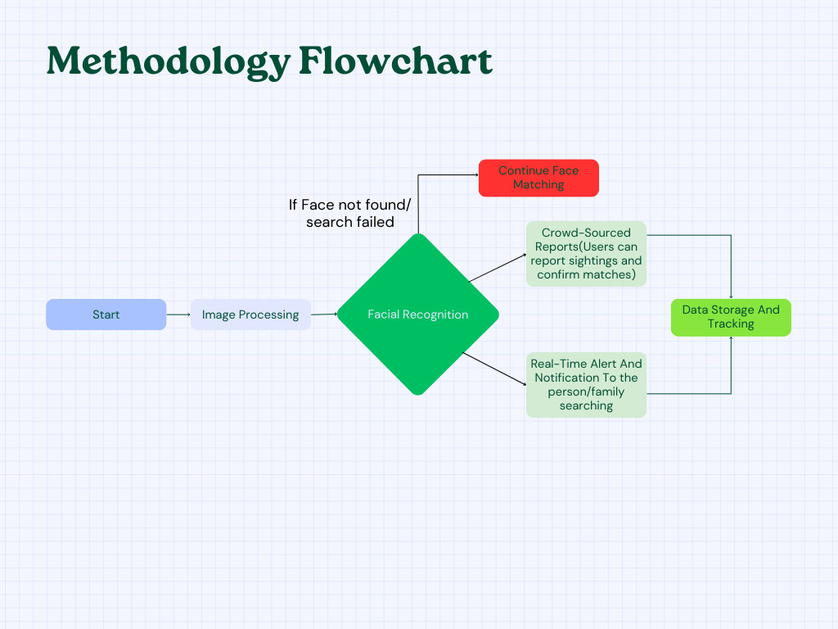
Methodology Flowchart
Notes:
New Courses replaced with New Programmes

Slide 10
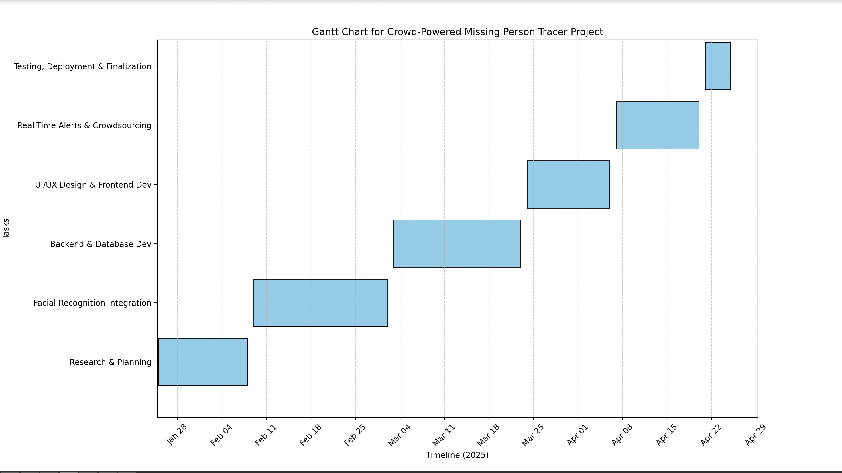
Project Timeline
Gantt Chart Made using MATPLOT lib Python
Notes:
New Courses replaced with New Programmes

Slide 11
Project Timeline
🔹 Phase 1: Research & Planning (Week 1-2)
📆 Jan 25 – Feb 8, 2025
✅ Research existing missing person tracking solutions
✅ Define system requirements (features, scalability, security)
✅ Assign roles to the 4 team members
✅ Choose tech stack:
• Frontend: React.js, Node.js
• Database: MySQl
• AI: OpenCV, dlib, NumPy, TensorFlow
✅ Design system architecture & flowchart
🔹 Phase 2: AI & Facial Recognition Integration (Week 9-10)
📆 Feb 9 – March 2, 2025
✅ Implement facial recognition using OpenCV, dlib, TensorFlow
✅ Process images with NumPy for matrix operations
✅ Train AI to match missing persons with CCTV/social media images
✅ Test AI model accuracy & optimize for real-time performance
🔹 Phase 3: Backend & Database Development (Week 6-8)
📆 Mar 3 – Mar 23, 2025
✅ Develop Flask/FastAPI backend
✅ Set up MySQL database
✅ Implement:
• User authentication & data encryption
• APIs for handling missing person data
• Data storage for reports & images
Notes:
New Courses replaced with New Programmes

Slide 12
Project Timeline
🔹 Phase 4: UI/UX Design & Frontend Development (Week 3-5)
📆 March 24 – April 6, 2025
✅ Design wireframes & UI mockups (Figma/Adobe XD)
✅ Develop React.js frontend
✅ Implement:
• User login/signup
• Form for missing person data upload
• Dashboard for families & law enforcement
✅ Set up Node.js backend for API connections
🔹 Phase 5: Real-Time Alerts & Crowdsourcing Features (Week 11-12)
📆 Apr 7 – Apr 20, 2025
✅ Develop real-time alert system (WebSockets/Firebase notifications)
✅ Enable crowd-powered reporting (users can submit sightings)
✅ Implement heatmaps for tracking missing persons
✅ Test end-to-end system functionality
🔹 Phase 6: Testing, Deployment & Finalization (Week 13-14)
📆 Apr 21 – Apr 25, 2025
✅ Conduct beta testing with sample cases
✅ Fix bugs & performance issues
✅ Deploy on AWS/GCP/Azure
✅ Prepare presentation & project documentation
Notes:
New Courses replaced with New Programmes

Slide 13
Expected Results & Impact
The expected output-
Increased success in finding missing individuals through AI face recognition and current tracking.
From the very start, there will be faster responses in integration of CCTV and other public contributions towards a single and unified system for the first place.
Lastly, the burden put on the police should be less due to confirmed cases and critical tracking.
Functional prototype and working model, that shows AI-driven identification and tracking through an application interface.
Impact -
Completely changes missing person searches by integrating AI, crowdsourcing, and real-time tracking in one efficient system.
Equips families and the public to be able to contribute in the search and increase awareness and engagement.
Potential application in law enforcement and emergency response, simplification of investigations, and safety measures.
Notes:
New Courses replaced with New Programmes

Slide 14
References
FaceRecognitionwithOpenCV(https://docs.opencv.org/4.x/da/d60/tutorial_face_main.html)
How to Implement TensorFlow Facial Recognition From ScratchKarthikShiralyDecember8,2022(https://www.width.ai/post/tensorflow-facial-recognition)
Other Resource such as GeekforGeeks,Stack Overflow etc.
Notes:
New Courses replaced with New Programmes

Slide 15
Instructions
No ChatGPT direct generated text, It can be used for improvements.

Slide 16
THANK YOU

